Slide 1
Technology Value Stream
By Gabriel Vance

Slide 2
Overview
Technology Value Stream
Lead Time
Processing Time
Deployment Lead Timers Requiring Months
Deployment Lead Times of Minutes
Resources

Slide 3
Technology Value Stream
Technology Value Stream
Technology required to turn an idea or hypothesis into technology for the customer.
Value
Value is determined by satisfying the needs of user stories.
Afterwards, planning processes start assigning which stories are more valuable than others.
In this process, developers assign necessity and functionality over comfort and ease.
Technology is built by coding the features users requested in their stories

Slide 4
Lead Time vs. Processing Time
Lead Time
Subset of the value stream.
Begins when a request is made of the subject.
Ends when the change is deployed and online (work completed).
Measures performance
Large portions of time are dedicated towards planning, which projects a theoretical piece of technology.

Slide 5
Lead Time vs. Processing Time
Process times
Begins when an engineer starts working on the project and ends when the work is completed.
Developing the technology impacts the finished project, creating longer or shorter process times.
While the times are subject to change, variability should be minimized.
Following development, engineers enter a Testing and Operations phase, wherein they test the product before it goes online.
Also known as task or touch time.

Slide 6
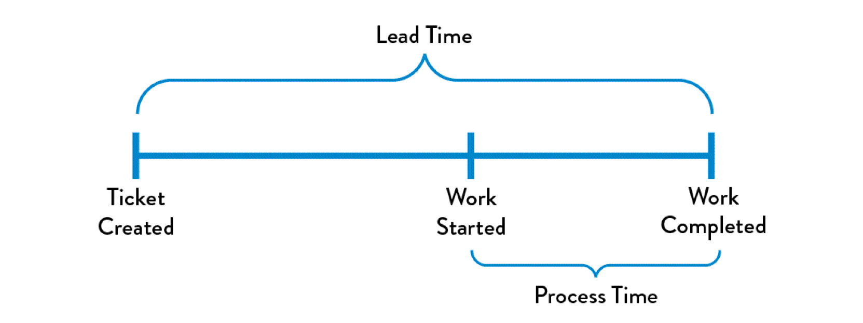
Lead Time vs. Processing Time
Gene Kim, Jez Humble, Patrick DeBois, John Willis (2015). DevOps Handbook. Page 9.

Slide 7
Deployment Lead Timers Requiring Months
Factors leading to long deployment times include:
Numerous tests
Long production phase
Manual/human work instead of “autopilot” development
Communication is a potential factor when several disjointed teams are working on the same project
Size and complexity of the project
While some of these factors cannot be avoided, it is important to note simple strategies to optimize time and resources. For example, creating milestones when bringing code together. This gives engineers a marker to fallback on should future prototypes fail.

Slide 8
Deployment Lead Times of Minutes
Lead time, the ticket to completion phase, can be measured in minutes.
By using numerous small teams, engineers can work autonomously of each other.
When working autonomously, errors are minimized and isolated or quarantined to certain sectors of code.
%C/A defines what percent of the stream is complete and accurate.
This helps paint a picture for the effective rate of the software should it go online now.
If the essentials are available and users can complete your task (i.e. 70% complete), the product can go online.

Slide 9
Resources
Agile Alliance (2018). Lead Time. Retrieved from:
https://www.agilealliance.org/glossary/lead-time/#q=~(filters~(postType~(~'page~'post~'aa_book~'aa_event_session~'aa_experience_report~'aa_glossary~'aa_research_paper~'aa_video)~tags~(~'lead*20time))~searchTerm~'~sort~false~sortDirection~'asc~page~1)
Flavio Picchi. Christopher Thompson (2016). The information value stream: analyzing the state of lean IT. Retrieved from:
http://planet-lean.com/the-information-value-stream-analysing-the-state-of-lean-it
Matthias Marschall (2014). How Reducing Lead Time with Continuous Delivery Will Help Your Users. Retrieved from:
http://blog.zend.com/2014/04/15/reducing-lead-time-with-continuous-delivery/

Slide 10
Resources
Michael Bowler (2015). Measurements Towards Continuous Delivery. Retrieved from:
http://www.agileadvice.com/2015/04/22/agileengineering/measurements-towards-continuous-delivery/
Troy DuMoulin (2014). IT Value Streams and Cultural Silos. Retrieved from:
http://www.ittoday.info/ITPerformanceImprovement/Articles/2014-01duMoulin.html
Ted Rivera (2010). How and why to create Value Streams for software engineering projects. Retrieved from:
https://www.ibm.com/developerworks/rational/library/10/howandwhytocreatevaluestreammapsforswengineerprojects/index.html

